Slide 1
Market basket analysis

Slide 2
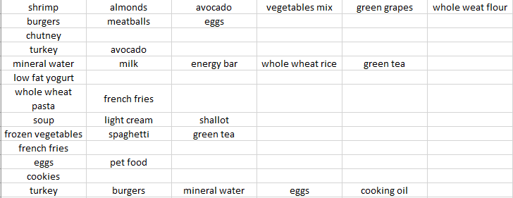
Info about data:
Here we have a sample of data on U.S. Supermarket, in which there are transaction details of a lot of customers which includes items they bought in single transaction(basket).

Slide 3
Procedure for Market basket analysis:
It seems that the apriori library in python is not working for now so I had to do each calculation manually.
Then I calculated Support, Confidence and Lift for each pair of items and got the Antecedents and Consequents.
Then I filtered the table with suitable values for Support, Confidence and Lift to get final results.
Then I removed the pairs of items which had equal Lift but lower Confidence so that we will have proper Antecedents and Consequents.
You’ll get to see these calculations on my github repository.

Slide 4
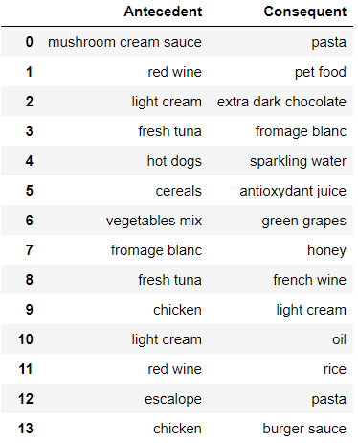
Final table(sample):
Antecedents are the items we usually buy first.
Consequents are the items we tend to buy after buying the Antecedents.
Pairing has been done on the basis of the value of Lift for them.

Slide 5
Suggestions:
Since I calculated manually there are some weird combinations like ‘Shallot and Cookies’ or ‘Herb & pepper and Clothes accessories’ or ‘Cooking oil and Protein bar’, we might have to remove those.
Also try filtering table with different values for Support, Confidence and Lift as you find suitable.
Otherwise this table provides better results for the current data.

Slide 6
Thank you

